Slide 1
A home built on the foundation of care

Slide 2
A keen observation – City suburbs
They were all located in & around manufacturing belts.
The workers who worked in the factories traveled large distances to reach the factory.
Most of these workers were migrants , living in rented rooms.
All had a desire to own a home.
All desired to keep their family happy.

Slide 3
We realized that very few builders were in affordable housing. Aapla Ghar literally means 'Apna Ghar' (Our Home). Aapla Ghar is an exclusive brand that understands customer needs by making home buying easy, by providing houses with all the modern amenities, without compromising on the quality. We decided on delivering one single promise of “ownership and happiness” in various upcoming locations across the city.

Slide 4
India Housing Day
'India Housing Day' showcased how buying can be made easy for the common man.
This was done by offering 1 BHK at 1 lakh, 2 BHK at 2 lakhs as a booking amount, and the remaining amount to be paid after possession.
Such a unique offer appealed to the needs of the buyer and was unheard of in real estate. The event was a huge success with more than 7,500 people attending the event and more than 1000 booking their brand new home - a dream they had cherished for years!

Slide 5
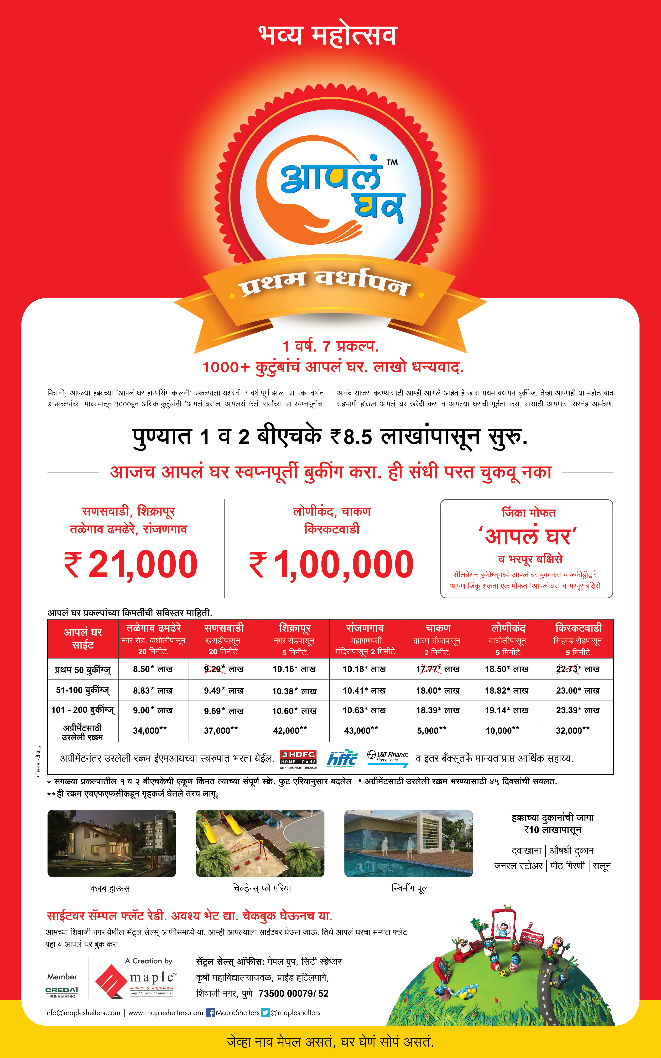
1st anniversary of Aapla Ghar
Here we came up with an offer to book your home in just Rs 21,000 plus stamp duty and registration.
It was a great celebration where we offered our customers with a lucky draw where the bumper prize was a 1 BHK flat.
Many more prizes were also up for grabs.
Here we received a tremendous response and a lot of referral bookings.
A total of 1200 flats were booked.

Slide 6
Project USP
Identifying daily needs of the customer
Society Bus will be provided for commuting between Project and city area.
Every residential project needs is a Medical Store. So we have made sure there’s a Medical Store in Aapla Ghar.
We all know importance of having a Clinic close to home. That’s why we have ensured there’s a clinic near Aapla Ghar.
There’s also a General Store for daily necessities.
Important but ignored by many societies is a Flour-mill. We have one in Aapla Ghar.
A Salon in Aapla Ghar to get a hair cut or a shave.
An ATM for your financial need.
Around each area of Aapla Ghar, has the fast developing industrial growth i.e. MIDC.
Nearby all Aapla Ghar are International Schools, Colleges, Banks & Market.

Slide 7
Construction in full swing

Slide 8
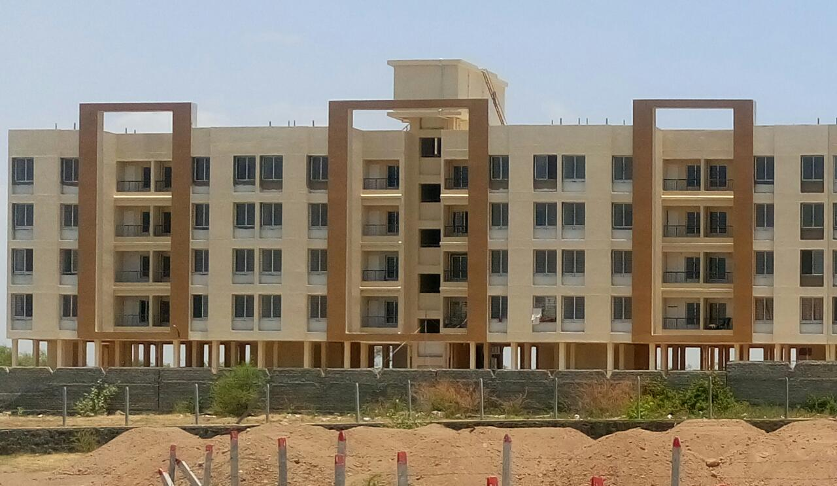
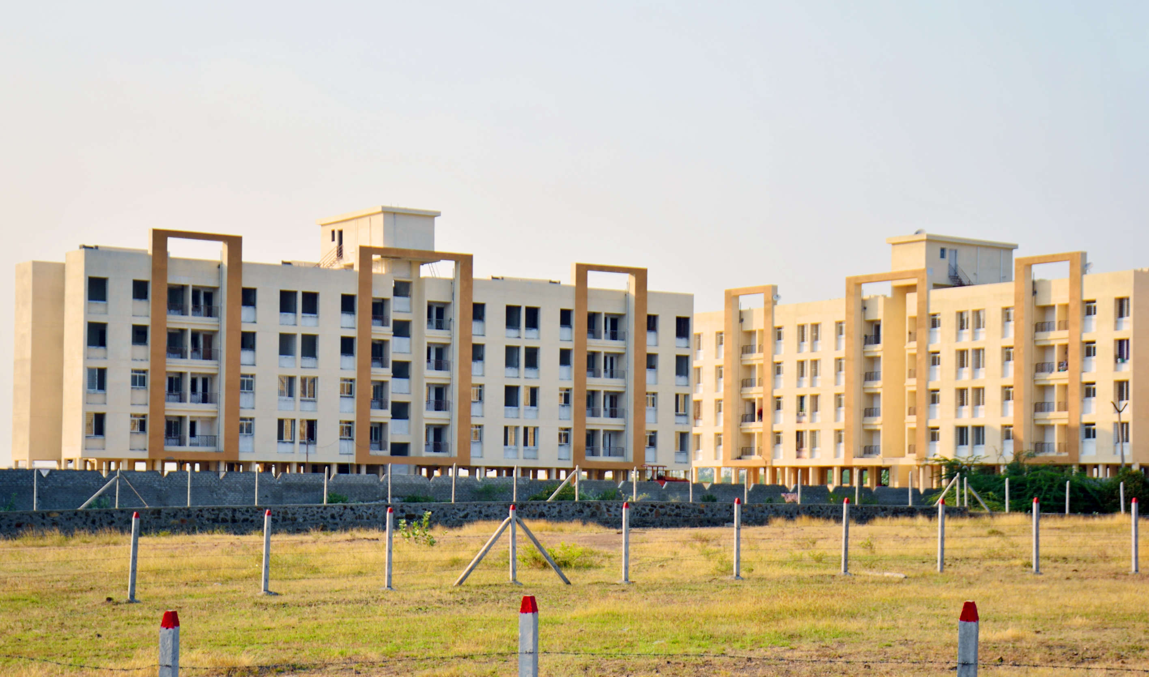
Our Ready Possession Sites
Aapla Ghar Sanaswadi - Pune

Slide 9
Aapla Ghar Ranjangaon - Pune

Slide 10
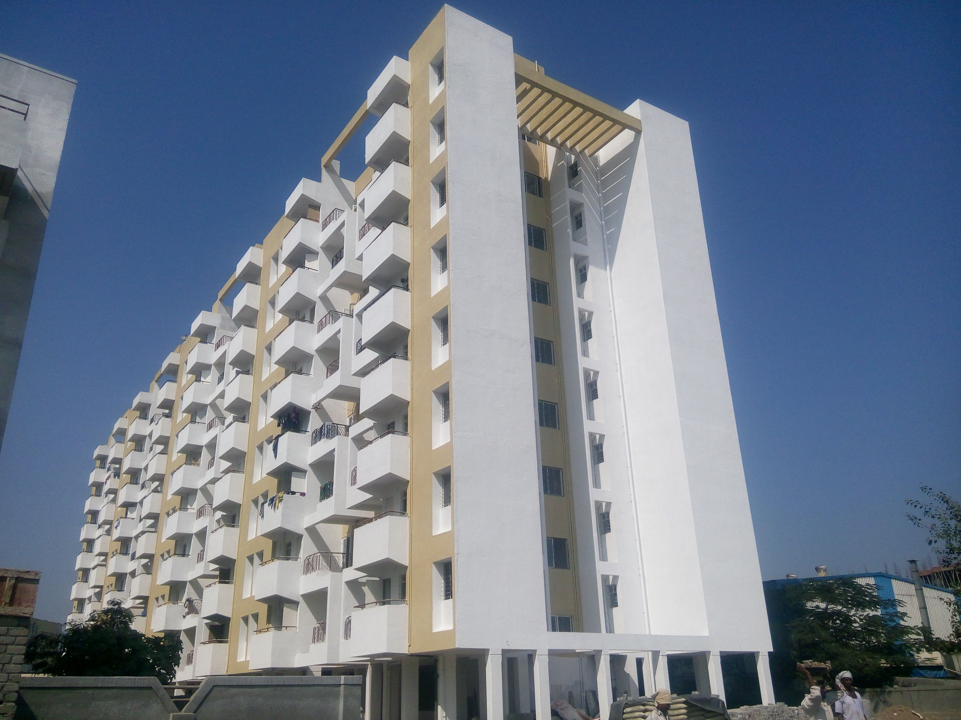
Completed Projects
Aapla Ghar Chakan - Pune

Slide 11
Handing over possession in style
We made it a very special occasion for thousands of our customers by hosting an event at the historic Shaniwar Wada.
Our customers are special. So we made sure they enter their new home in style!

Slide 12
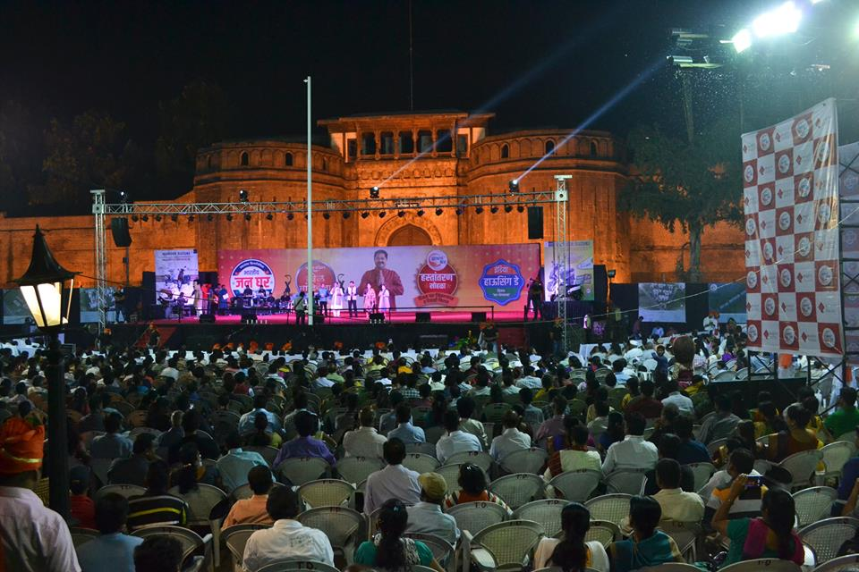
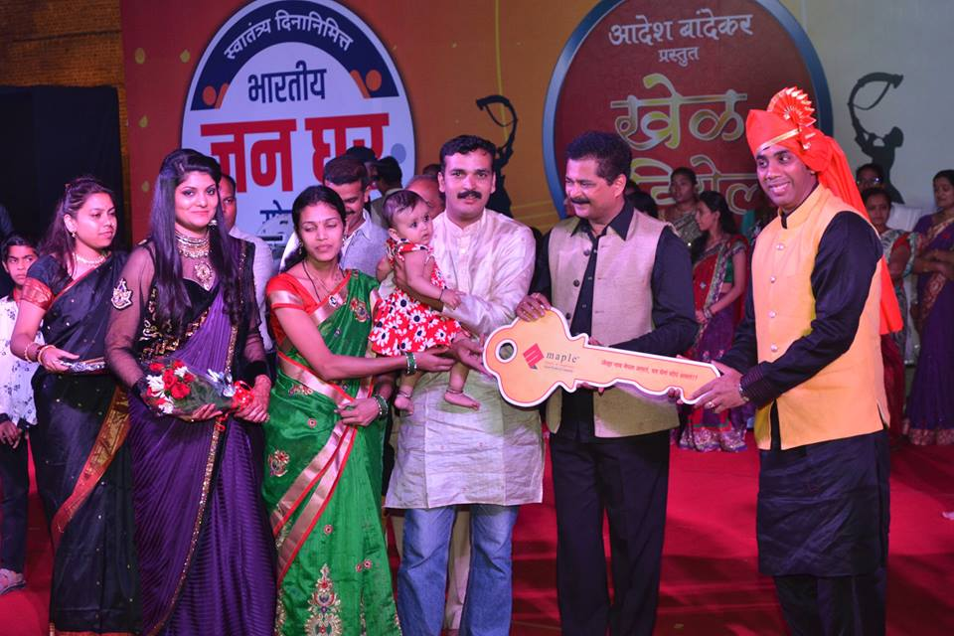
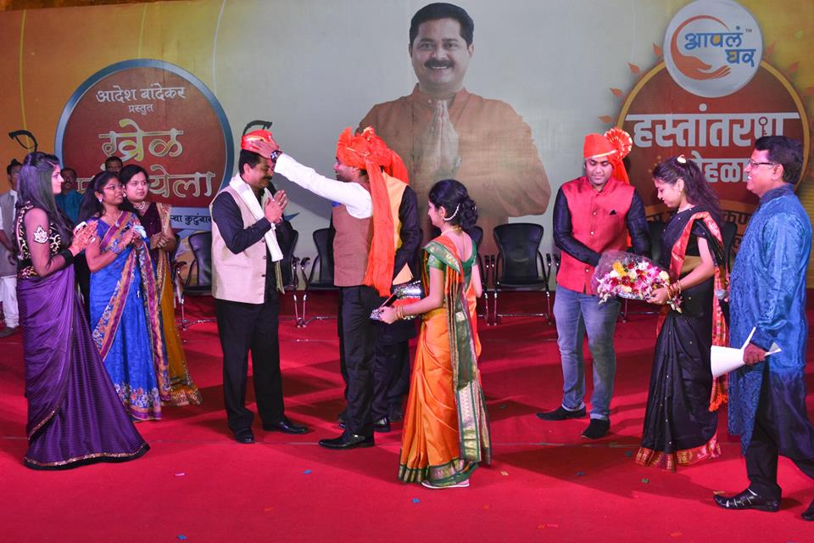
.

Slide 13
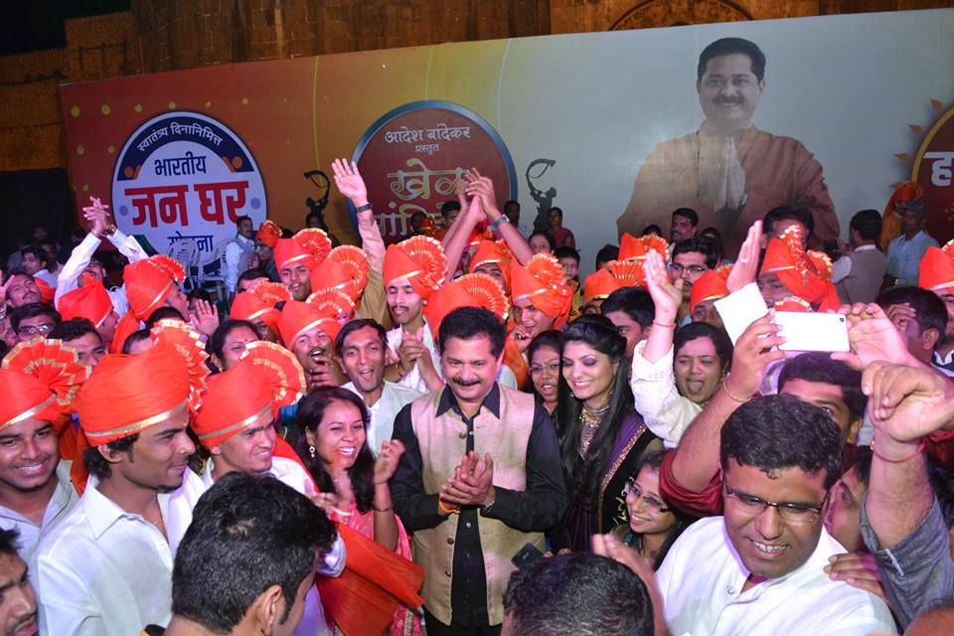

Slide 14
Aapla Ghar CSR
We extended our philosophy of providing low cost housing to provide shelter to a few hundred women who take the annual Wari from Alandi in Pune to Pandharpur.
It definitely got us some blessings from the needy. Don't take our word for it. See it for yourselves! And it also won us an award for our Advertising agency.

Slide 15
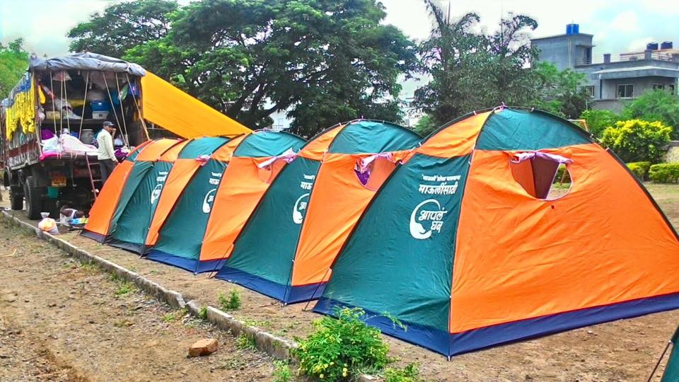

Slide 16
Sustaining & Growing in the affordable housing segment:
Profitability depends upon the volume.
Connecting with the consumer at the emotional level with through Low downpayment and No EMI till possession.
The best medium to reach the TG is through print ads and TV commercials.
Taking calculated risks for nullifying any shortcomings about your project just to ensure a convenient living experience.
Paying meticulous attention to the legal formalities
The company should be debt free for affordable housing.
Due to thin margins the project should be completed before time.

Slide 17
The Debacle:
In 2015, the Ministry of Housing and Urban Poverty Alleviation launched the PMAY to provide housing for the masses.
Since the aim of the program aligned with our vision, we launched the campaign ‘Maharashtra Housing Day’ to reach a larger group of consumers with an attractive offer.
Fanatically driven by our vision and in the heat of the moment we missed out on some crucial legal terms behind the PMAY program, due to which the campaign capsized.

Slide 18
Precautions:
Pay meticulous attention to the legal terms.
Don't take anything for granted.
Calmly plan everything.
Take care that campaign should not be misinterpreted.
THANK YOU

